Slide 1
Joint Ventures and the Option to Expand and Acquire
Bruce Kogut (1991)

Slide 2
Theoretical Background
Research Background: the decision to invest and expand into new product markets characterized by uncertain demand + The task of building a market position and competitive capabilities requires lumpy (indivisible) and non-trivial investments
Real Option: Real investment in operating as opposed to financial capital; Option – it need never be exercised.
Joint Venture: through pooling resources of two or more firms, firms can build a market position and competitive capabilities beyond its own resources: not only risk/cost-sharing but also total investment saving
In the event the investment is judged to be favorable:
1. Further commitment of capital – partners’ renegotiation
2. The party placing a higher economic value on this new capital commitment buys out the other
Timing: When it is desirable to exercise the option to expand is likely to be linked to the time when the venture will be acquired.

Slide 3
Research Questions
To explain the governance choice of equity joint venture and its outcome by utilizing a real option perspective：
How do firms strategically utilize joint ventures as real options to navigate uncertain market conditions, capitalize on emerging opportunities, and manage risks in dynamic business environments?
To empirically test the link in the timing of the acquisition of joint ventures and of the exercise of the option to expand：
What factors influence the decision-making process of firms in determining the timing of acquisitions within joint ventures?

Slide 4
Real Options
Joint ventures are real options, not in terms of the legal assignment of contingent rights, but, like many investments, in terms of the economic opportunities to expand and grow in the future.
The value of any investment = cash flows stemming from assets as currently in place + those stemming from their redeployment or future expansion (the value of growth opportunities)
Idiosyncratic valuation: As both the value of the assets in place and the option can be potentially affected by current assets and opportunities of the partner firms, the valuations of the venture will differ among the parties (spillover, complementary effects).
π: the current value of an uncertain state variable → may be altered in the future

Slide 5
Joint Ventures as Real Options
First Option: waiting to invest + Second Option: Option to expand
It pays to wait before committing resources
Prior investment commitment is necessary to have the right to expand in the future
Through the joint venture, the buying party has acquired the skills of the partner firm and no longer needs to invest in the development of the requisite capability to expand into the targeted market
Divesting firm: capital gains realization; may not have complementary assets
Market vs Acquisition: the net value of purchasing the joint venture < = the value of purchasing comparable assets on the market. (Better information and the gain in experience)

Slide 6
Timing of Exercise
The acquisition is justified only when the perceived value to the buyer is greater than the exercise price.
Financial options: held to full maturity; Real option: immediate exercise
Why JV acquisitions happen once it is profitable to exercise the option?
1. the value of the real option is only recognized by making the investment and realizing the incremental cash flows.
2. the necessity to increase the capitalization of the venture invariably requires a renegotiation of the agreement, often leading to its termination
Two key considerations of timing: the initial base rate forecast underlying the valuation of the business and the value of the venture to each party (or third parties) as realized over time.
Hypothesis: The venture will be acquired when its valuation exceeds the base rate forecast.

Slide 7
Empirical Context
Selective Cues and Market Valuation
the acquisition of a joint venture as an irregular decision which responds to two time-varying specifications of the market cues
The short-term annual growth rate
An annual residual error from a long-term trend
Acquisition and Value of Assets in Place
Divergent motivations to joint venture
the present value of the assets in their current use vs the option to expand or redeploy
share scale economies, coordinate the management of potentially excess capacity, and so on
Why do the parties not agree to an immediate acquisition?
(1) Learning considerations(Divesting party is contracted to pass on complex know-how on the running of
the business & slow an erosion in customer confidence)
(2) Pre-emption considerations (not divest to prevent other competitors to acquire)

Slide 8
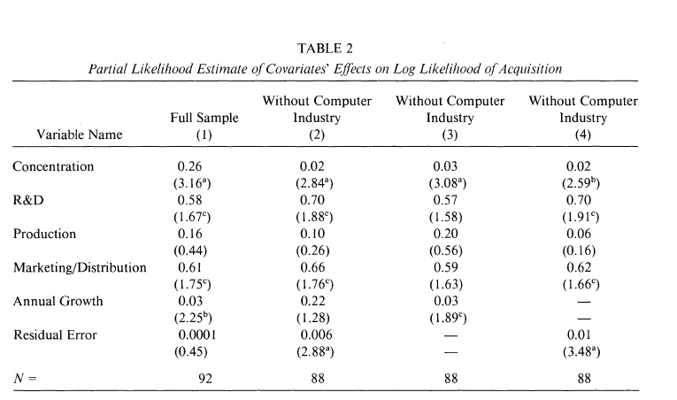
Methodology
Data were collected from both questionnaire and archival sources.
140 joint ventures with at least one American partner; 92 manufacturing
Dependent variable:
Acquisition: dummy variable
Independent variable:
Three dummy variables (R&D, Production and Marketing): indicating whether the venture included any of these activities.
Concentration: four-firm concentration ratio at the four-digit SIC level
Two selective cues: Annual Growth and Annual Residual Error

Slide 9
Results
In concentrated industries, joint ventures appear to be used as an intermediary step towards a complete acquisition, Acquisition Timing Patterns.
Ventures with R&D activities or marketing and distribution activities are more likely to be acquired, Market Signal Effects.
Managers are sensitive to a long-term intra-industry base rate, which serves as a standard by which to evaluate annual changes, Value Creation Strategies, Risk Management Practices.

